Slide 1
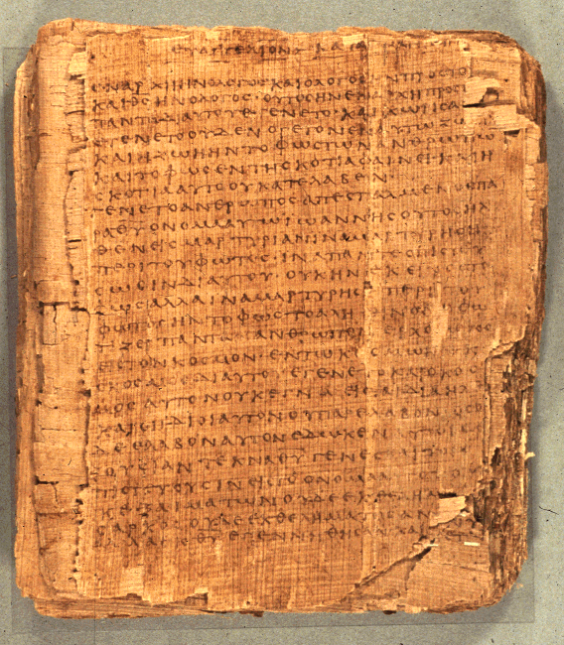
Comprehending the Psalms
Dr. Rodney K. Duke

Slide 2
CLASS 5
Assign:
Enjoy reading the psalms!
Day Objectives:
Explain the roles of the priests and levites in the temple use of the psalms.
Explaining the historical development of the Psalter.
Recognizing other psalm types.
Practice diagramming “balanced thought structures” and observing how they communicate meaning.

Slide 3
JOURNAL THOUGHTS & OBSERVATIONS

Slide 4
Functions of the Priesthood
Set apart (sanctified) as intermediaries between God and people in “dangerous” sacred space, time, and actions of Temple cult.
Taught Torah in terms of holiness (clean and unclean).
Led people into battle in early period.
In the OT the people of Israel were called to be holy: NIV Leviticus 20:7-8, "Consecrate yourselves and be holy, because I am the LORD your God. Keep my decrees and follow them. I am the LORD, who makes you holy.” (also 11:44,45; 9:2; 20:7) [1) For their good/life. 2) To be a royal priesthood]
People called to “make a distinction” and share in the divine creational activity. (Gen 1:4,7)
Priestly role of “distinguishing”: Leviticus 10:10, “You must distinguish between the holy and the common, between the unclean and the clean.”
Notes:
Quote from Bonhoffer?: The Church is the new humanity of Jesus. [I.e. we are to reveal God’s holiness.]

Slide 5
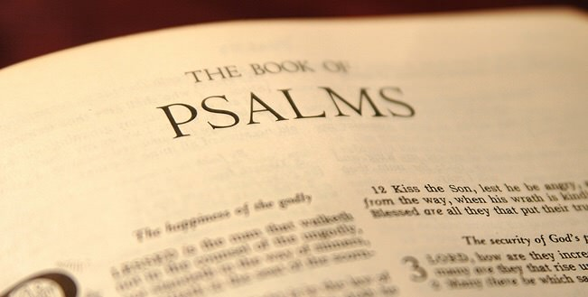
HISTORICAL BACKGROUND TO THE PSALTER AS WE HAVE IT TODAY
This Photo by Unknown Author is licensed under CC BY-SA-NC

Slide 6
Background on Psalms (Handouts, pp. 30-33)
I. Historical Context of the Psalms
A. Relationship to ANE literature
1. Similar: cultic function; style; content of petitioning, lamenting, praising; (types?)
2. Different: theology and world-view; no mythic enactment
B. Authorship/Origin
1. Cannot be certain titles indicate authorship [some probably from David and some probably from Levitical-priest musicians
2. Debate about personal vs. cultic origin
C. Setting of transmission/employment
1. Transmission and preservation: temple functionaries
2. Employment: cultic rituals connected w/Temple
D. Collection/Preservation
Probably the music guilds of the Levitical-priests
E. Role of the priest
1. Teach the Law
2. Guide and guard the cultic rituals: sacrifices, worship

Slide 7
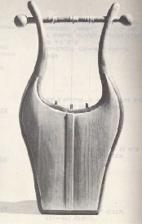
UNIT 3. BACKGROUND ON PSALMS (2 of 8)
II. Psalms Outside the Psalter (particularly in prophets)
1. Ex. 15:1-18, 20-21, (Song of the Sea).
2. Dt. 32:1-43, (Song of Moses).
3. Jdg. 5:1-31, (Song of Deborah).
4. 1 Sam. 2:1-10, (Song of Hannah).
5. 2 Sam. 22:2-51, (Psalm of David, also Ps. 18).
6. Isa. 12:4-6, (Thanksgiving).
7. Isa. 39:9-20, (Song of Hezekiah).
8. Isa. 42:10-12; 52:1-10.
9. Hab. 3:2-19, (Hymn of Praise).
10. Jonah 2:1-9 (Jonah's Prayer from the Belly of the Fish).
11. Job 5:8-16; 9:10-14; 12:7-10, 13-25 (Hymns); 3:3-12, 13-19, 20-26; 7:1-10, 12-21; 9:2-31; 10:1-22 (Laments.)
12. Jer. 15:15-18; 17:14-18; 18:9-23, (Laments) also Lam. Ch. 3,5.
Read Jonah 2:2-9
What type of Psalm is this?

Slide 8
UNIT 3...BACKGROUND ON PSALMS (3 of 8)
III. Growth of Psalter (probable)
A. 1st stage: individual psalms (superscriptions?)
B. 2nd stage: superscriptions/titles (postscripts) added
C. 3rd stage: collected according to titles (cf. Ps 72:20) by Levitical priests who were responsible for music
Collections of Psalms Within the Psalter
1. Davidic Collection, 3-41.
2. Korah Musical Guild, 42-49.
3. Davidic Collection, 51-72.
4. Asaph Musical Guild, 73-78, Ps. 50.
5. Various Musical Guilds, 84-89.
6. Various Other Collections, 90-150, including
(a) Psalms of Yahweh's Kingship, 93-99.
(b) Psalms of Pilgrimage, 120-134.
(c) Hallelujah 104-106, 111-113, 135, 146, 150.

Slide 9
UNIT 3. BACKGROUND ON PSALMS (4 of 8) D. 4th stage: collection into “books” Structure of the Psalter
Book 1: Psalms 1-41
Concluding Doxology, 41:13
Book 2: Psalms 42-72
Concluding Doxology 72:18-19
Book 3: Psalms 73-89
Concluding Doxology 89:52
Book 4: Psalms 90-106
Concluding Doxology 106:48
Book 5: 107-150
Concluding Doxology for entire Psalter, Psalm 150
God/Elohim Lord/Yahweh
15 272
Elohistic Psalter
164 30
14 370
Read Psalms 14 and 53. What do you observe?

Slide 10
UNIT 3. BACKGROUND ON PSALMS (5 of 8)
D. 4th stage: collection into “books” (cont.)
Note parallel psalms/sections:
Ps 14 = Ps 53
Ps 40:13-17 = Ps 50
Ps 57:7-11 +Ps 60:5-12 = Ps 108
E. 5th Stage: Five Book Arrangement
Bk 1 “Davidic/royal” perspective (lament w/hope focus)
Bk 2: “Davidic/royal” perspective (success focus)
Bk 3: Failures down to Babylonian Exile (dark)
Bk 4: In Exile (some “Mosaic” hope for deliverance*)
Bk 5: Restored Israel offers praise
Pss 1-2: Introduction
Pss 145-50 - Finale
Possible rearrangement for 3-year lectionary cycle, 4 per Sabbath? for synagogue use?
*Moses mentioned 7 times: (90:1; 99:6; 103:7; 105:26; 106:16,23,32)

Slide 11
UNIT 3. BACKGROUND ON PSALMS (6 of 8)
IV. Superscriptions/Titles (126 psalms) [any postscripts?]
A. Types of information:
1. linked to person with lamed (to, for, by)
2. technical name for psalm types
3. musical terms
4. melody indicators
5. liturgical indicators
6. historical connection to life of David
B. Evaluation:
1. Could be primary or secondary
2. Cannot safely assume lamed (A 1) means “authored by” in all cases*
3. Useful to read in light of historical notices (See Psalm 51)
*See how Ps 110 (“l-David”) seems to speak prophetically about David/Davidic king.

Slide 12
Review: UNIT 3...BACKGROUND ON PSALMS (7 of 8)
V. Theological Basis and/or Implications
Each psalm has own distinct message; but some generalizations:
A. Petitions:
1. God is to be approached boldly, with complete openness
2. Even in despair, the psalmist expressed trust
B. Thanksgivings:
1. God is to be thanked by testimony before community in celebration
2. God is experientially knowable
3. Faith in God who acts on their behalf
C. Hymns:
1. God is worthy of praise
2. God, who is majestic and sovereign, graciously condescends to care for those who trust God

Slide 13
UNIT 3...BACKGROUND ON PSALMS (8 of 8)
VI. Principles for Application
A. Can I identify or empathize with the psalmist's situation and/or feelings? (subjective)
B. Can/should this psalm provide a model for me when speaking to God or others about God? (subjective)
Caution: elements of imprecation
C. What is the psalmist teaching about the God-humanity relationship and/or about how life works? (objective)
Caution: not the same as explicitly taught doctrine

Slide 14
TOWARDS A
LITERARY DESCRIPTION
&
READING STRATEGY
Communication Chart

Slide 15
Hymnic Literature (Handouts, p. 28)
Literary Features /Impact Be able to give some lit. features & impact
1. General
a. poetic:
1) parallelism (balanced thought structures)
2) figurative language (e.g. hyperbole, metaphor, simile, personification, merism)
3) graphic, picturesque language
4) (all of the above) densely packed
B. "lofty" (theological)
C. intensely personal language (testimonial; bold, honest, emotional, emphatic)
D. direct address
E. questions and answers
(etc.)

Slide 16
READING STRATEGY (Handouts, p. 29)
Analyze (Many of the "steps" are not sequential, but simultaneous.)
1. Identify type of psalm.
2. Seek to recover historical and cultic setting.
3. Outline the general structure.
a. What are the main sections and their motifs?
b. What is the connection/flow of thought among sections?
4. Identify the flow of thought and topics within each section.
5. Identify/diagram the structural patterns among the verses.
What impact are these structures meant to have?
6. Identify/diagram the parallelism (balanced structures) within verses. What are the relationships between the balanced elements?
7. Identify the figures of speech and explore how each one "works."
8. Focus on the graphic language and ask what it is meant to evoke. (Discover the emotive, conative and persuasive elements.)

Slide 17
READING STRATEGY (2 of 3)
9. Look for allusions to other OT events and texts.
What would this relationship indicate?
* 10. If the title/superscription gives a setting (e.g. in the life of
David), look up that event and explore what this perspective would add to the themes and mood of the psalm.* * (This step moves away from a form-critical reading to a “historical” reading. Perhaps used outside of Temple in a synagogue setting.
Synthesize
1. What is/are the psalmist's intention/s?
2. What is the psalmist's situation (personally, cultic)?
3. What is the psalmist feeling and experiencing?
4. What is/are the psalmist's thesis/theses?

Slide 18
READING STRATEGY (3 of 3)
Application
1. Can I identify or empathize with the psalmist's situation and/or
feelings?
2. What is the psalmist teaching (implicitly or explicitly) about the God-human relationship and/or about how life works?
3. Can/should this psalm provide a model when speaking to God or others about God?

Slide 19
Questions over Course Pack reading on
“Balanced Thought Structures”?

Slide 20
In groups: reconstruct possible cultic setting.
Psalm 24
I.
Proclamation of Yahweh’s Ownership of the World
1) To Yahweh belongs the earth and its fullness, the world and all who dwell in it;
2) for He founded it upon the seas and established it upon the rivers.

Slide 21
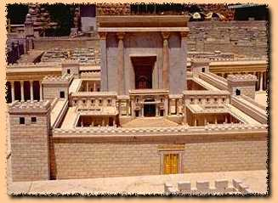
II.
“Catechism” for Approaching Yahweh
A. Question
3) Who may ascend the mountain of Yahweh and who may stand in His holy place?
4) One innocent of hands and one pure of heart one who does not lift up his soul to falseness and one who does not swear deceitfully.
5) He receives blessing from Yahweh and vindication from the God of his salvation.
6) Such is the generation of those seeking Him; those seeking Your face are Jacob.
B. Answer
C. Result
D. Identification

Slide 22
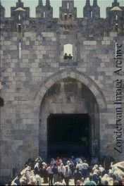
Psalm 24
III.
Entrance Liturgy
7) Lift up your heads, O gates, and lift yourselves up, O ancient doors, so that the glorious King may enter!
8) Who is the glorious King? Yahweh, powerful and mighty; Yahweh, mighty in battle!
9) Lift up your heads, O gates, and lift up, O ancient doors, so that the glorious King may enter!
10) Who is this glorious King?
Yahweh of hosts;
He is the glorious King!
A
B
A
B
Damascus Gate in Jerusalem

Slide 23
Proclamation of Yahweh’s Ownership of the World
Psalm 24
1) To Yahweh belongs the earth and fullness of her, the world and the dwellers in her;
2) for He upon the seas founded her and upon the rivers established her.
3) Who may ascend the mountain of Yahweh and who may stand in His holy place?
4) One innocent of hands and one pure of heart; one who does not lift up his soul to falseness,
and one who does not swear deceitfully.
5) He receives blessing from Yahweh, and vindication from the God of his salvation.
6) Such is the generation of those seeking Him; those seeking Your face are Jacob.
7) Lift up your heads, O gates, and lift yourselves up, O ancient doors,
so that the glorious King may enter!
8) Who is the glorious King? Yahweh, powerful and mighty;
Yahweh, mighty in battle!
9) Lift up your heads, O gates, and lift up, O ancient doors,
so that the glorious King may enter!
10) Who is this glorious King? Yahweh of hosts;
He is the glorious King!
SOVEREIGNTY OVER CREATION
“Catechism” for Approaching Yahweh
ENTERING SACRED SPACE
Entrance Liturgy
KINGSHIP & BATTLE IMAGES

Slide 24
Observations
Most of the verses have a movement from a broad category in the first clause to greater specificity in the second (“parallelism of greater precision” [Clines]).
The patterns of balanced thought structures not only help to set apart one section from another but their intricacy calls attention to section II and particularly verse 4.
I. Proclamation of Yahweh’s Ownership of the World
1) A B C / [A] B C
2) A B C / [A] B C
II. “Catechism” for Approaching Yahweh*
3) A B / A B
4) is unique*
5) A B C / [A] B C
6) A B / B A
III. Entrance Liturgy
7) A B / A B / C (A)
8) C / D E / D E (B)
9) A B / A B / C (A) 10) C / D E / C (B)
*Each verse is different and the most intricate pattern of balanced thought structures is found in verse 4. (Next slides)
Notes:
Moving to greater specificity:
Semantic hierarchy example: father = noun, singular, animate, human, parent, male, father.
Paradigmatic association usually replaces one of the lower levels with the opposite (e.g. "mother").
But parallelism of greater specificity moves down: from "parent" to "father" from "field" to vineyard" etc.

Slide 25
4) Answer
>
[One] clean of hands
Stated from the positive perspective
And [one] pure of heart,
= completely pure
Who does not lift to falseness My/his soul,
Stated from the negative perspective
And [who] does not swear to deceit.

Slide 26
4) Answer
POSITIVE
[One] clean of hands
outward
Merism for completely pure
And [one] pure of heart,
inward
NEGATIVE
Who does not lift to falseness My/his soul,
inward
Merism for completely pure
And [who] does not swear to deceit.
outward

Slide 27
4) Answer
POSITVE
[One] clean of hands
Outward A
And [one] pure of heart,
Inward B
Chiasm for complete-ly pure
NEGATIVE
Who does not lift to falseness My/his soul,
Inward B
And [who] does not swear to deceit.
Outward A

Slide 28
PSALM 56 (A Psalm of Lament)
Look for chiasm
Verses 3-4 (Trust Section)
When I am afraid,
In You I will trust.
In God, whose word I praise,
In God, I do trust; I will not be afraid.
[What can flesh do to me?]
A) When I am afraid
B) In You I will trust
C) in God
D) whose word I praise
C) in God
B) I do trust
A) I will not be afraid
[Therefore:]
What can flesh do to me?

Slide 29
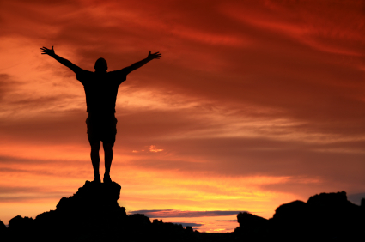
PSALM 56
Look for chiasm
Verses 9-11 (2nd Trust Section)
Then my enemies will turn back, in the day I cry out;
This I know: that God is for me.
In God I will praise [His] word,
In Yahweh I will praise [His] word.
In God I do trust, I will not fear;
What can man do to me?

Slide 30
PSALM 56
Look for chiasm
Verses 9-11 (2nd Trust Section)
Then my enemies will turn back, in the day I cry out;
This I know: that God is for me.
In God I will praise [His] word,
In Yahweh I will praise [His] word.
In God I do trust, I will not fear;
What can man do to me?

Slide 31
PSALM 56
Verses 9-11 (2nd Trust Section)
A) Then my enemies will turn back,
B) In the day I cry out;
C) This I know: that God is for me.
D) In God I will praise [His] word,
D) In Yahweh I will praise [His] word.
C) In God I do trust,
B) I will not fear;
A) What can man do to me?

Slide 32
Personal Summary / Discussion
Obj.: Reflect on the value of the hymnic literature for Christian faith and practice.
Based on your current knowledge of the Psalms and Temple worship, why is valuable for Christians to read and study the Psalms?

